Slide 1
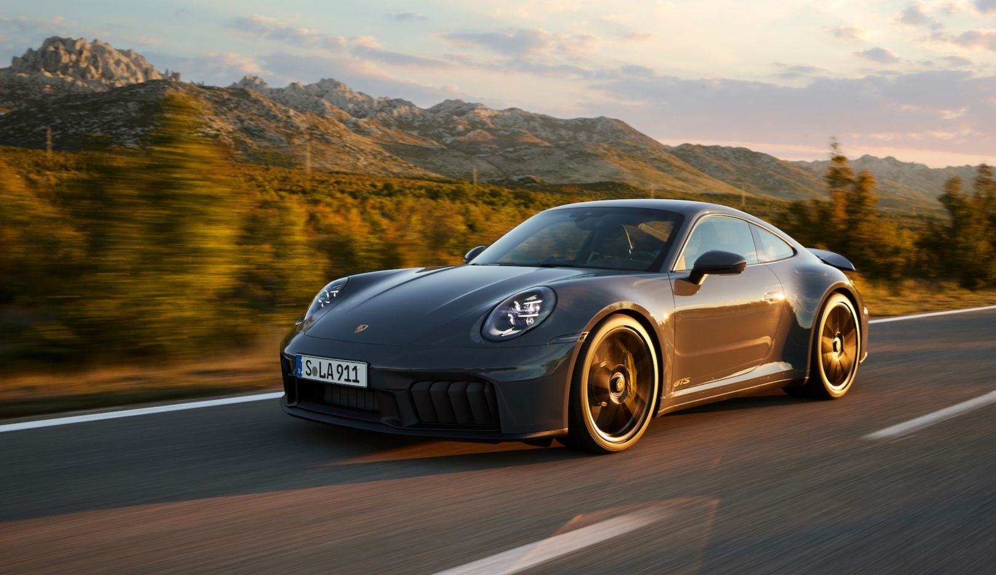

AI and ChatGPT
MIDTERM REVIEW
Team: TW@Porsche

Slide 2
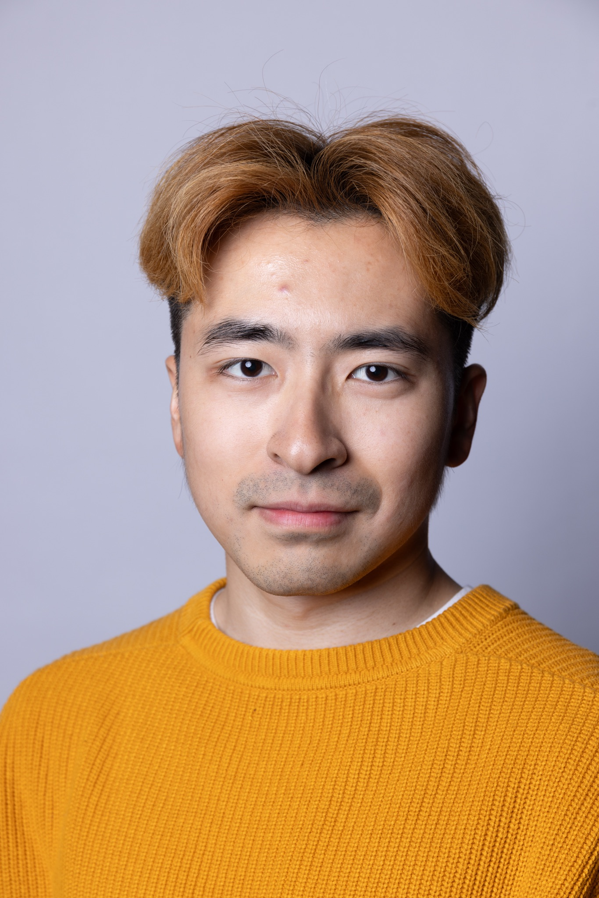
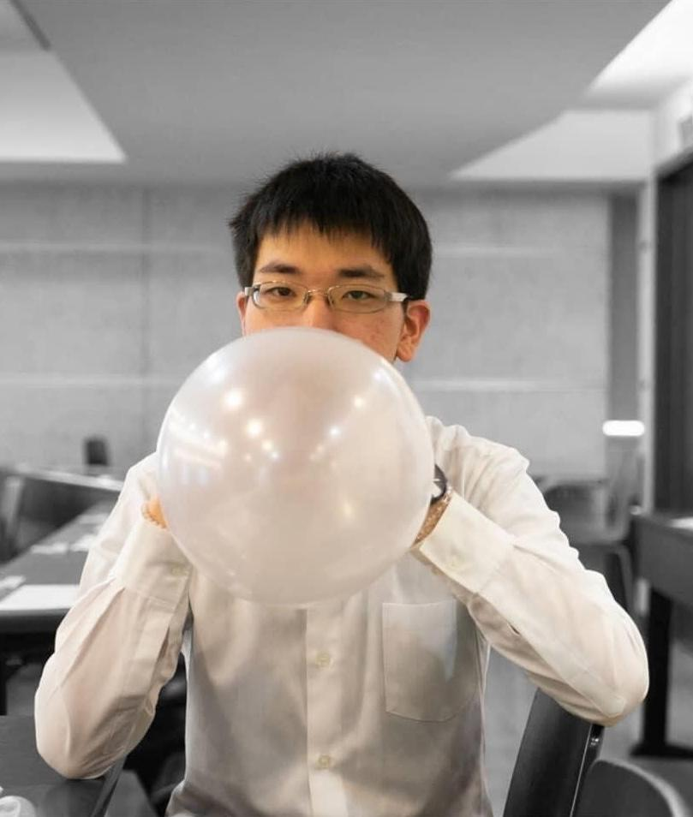
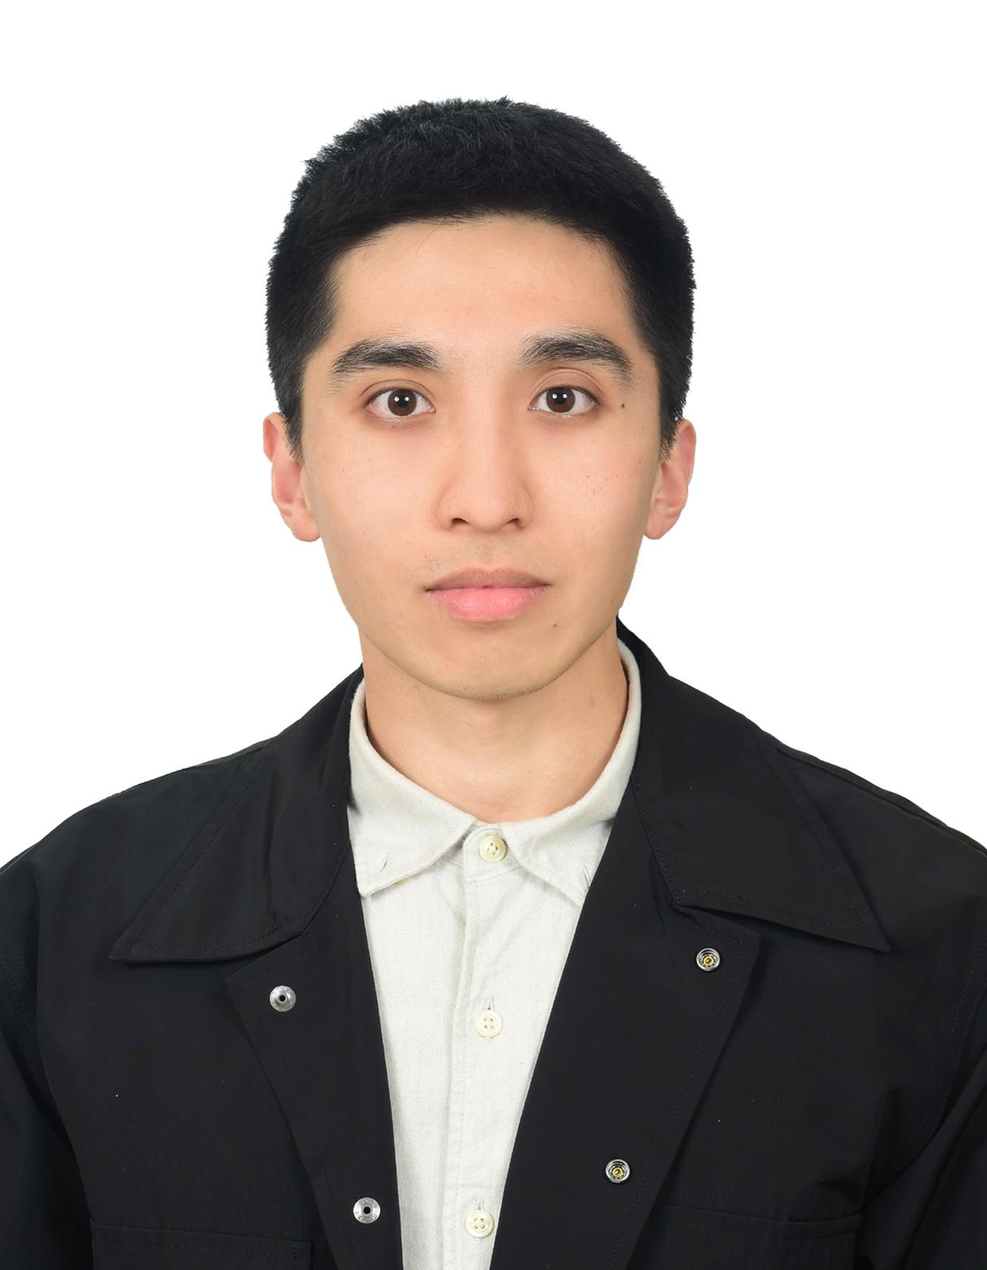
Our Team
Po-Yen Chen Simulation Sciences, RWTH Aachen
Data and numerical analysis, implement the data-driven method to chemical and mechanical engineering problem, did more than related three interdisciplinarily internal and external projects during my study
Ling-Chia Chen Computer Science, University of Stuttgart
NLP model fine-tuning, implement Voice Recognition and Language Model to an AI customer service system, design and develop projects related to system automation.
Chia Hao Chang (Gary) Simulation Sciences, RWTH Aachen
Deep Learning in NLP and Computer Vision, Reinforcement learning
Utilize LLM in computational argumentation
Computer vision working student at RWTH ISAC lab to analyze traffic flow via end-to-end object detectors.

Slide 3
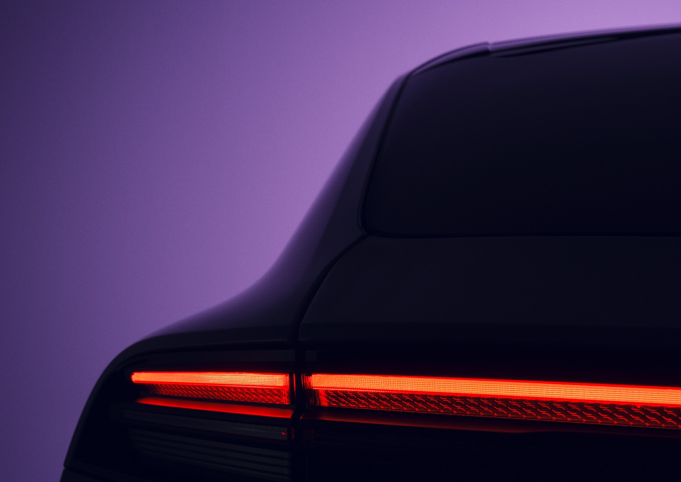
Outline
Introduction
Methodology
Current work
Future work

Slide 4
Outline
Introduction
Methodology
Current work
Future work

Slide 5



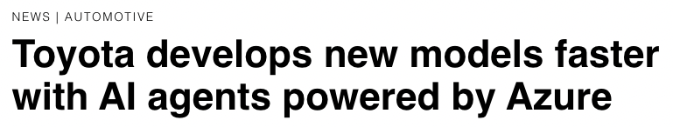
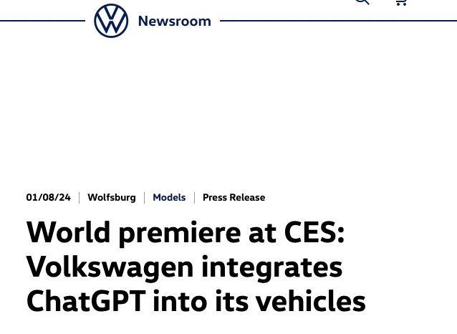
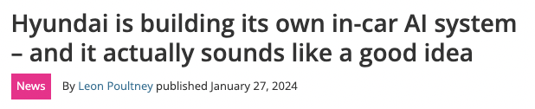
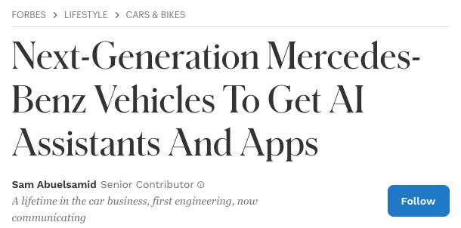
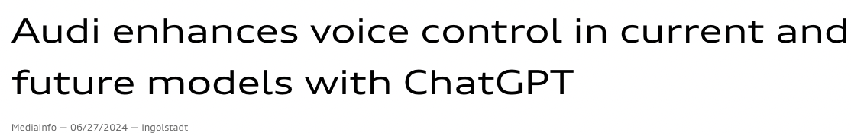
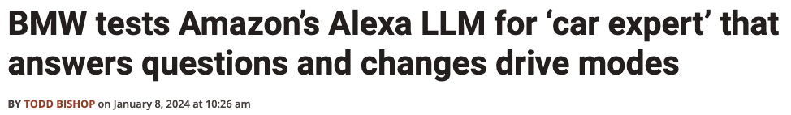
Background
Huge hype in language models since ChatGPT came out.
Swept over different areas of industry. No exception for automotive industry.

Slide 6
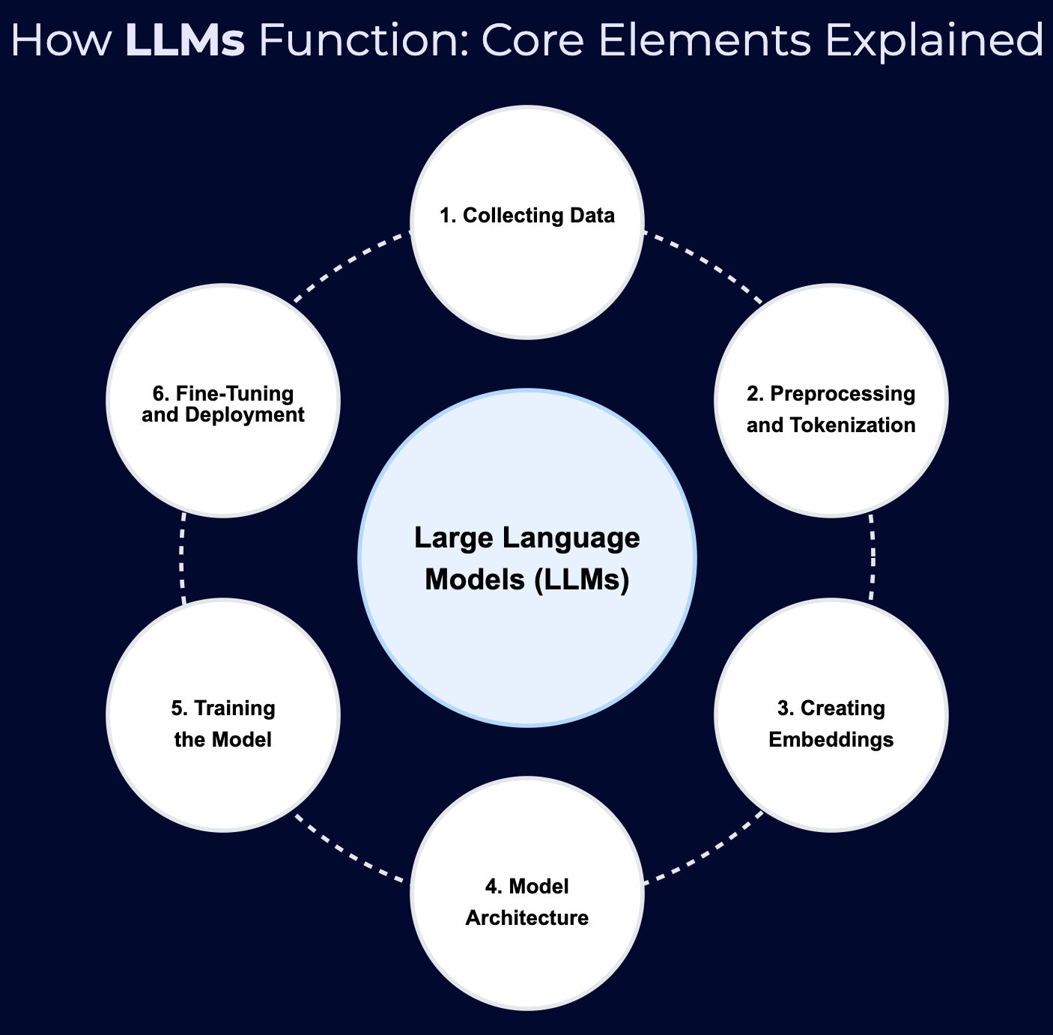
Recipes behind LLM
Tokenizer
Embedding
Transformer
Image source: https://www.confidentialmind.com/post/embeddings-and-llms#

Slide 7
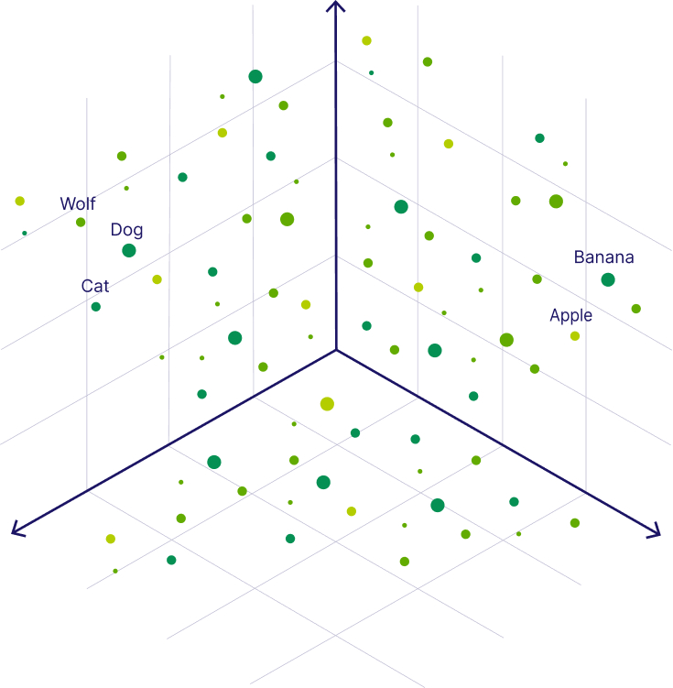
Problem Understanding
In general, why do we need to fine tuning text embedding models?
Issue 1: Correct answer but low similarity
User Query 1
User Query 1:
What is the unique feature of the Cayenne Turbo GT?
Answer 1:
It offers 471 kW (640 PS) and is optimized for high performance.
Similarity score: 0.4106892943382263
User Query 2
Answer 2
Issue 2: Wrong answer but high similarity
User Query 2:
What is the history of Cayenne?
Answer 2:
The history of Cayenne can be first traced back to pre-Columbian times.
Similarity score: 0.8268212676048279
Answer 1
Image modified from https://weaviate.io/blog/vector-embeddings-explained

Slide 8

Idea proposal – Car recommendation system
Build a recommendation engine that suggests particular car models, based on the customer‘s preferences and needs, helping potential buyers to have better decision-making.
First, represent products in embedding space. Then, customers can input their requirements, such as budget, preferred body type, fuel efficiency and desired features. Text embedding model can then use similarity search to generate personalized recommendations.
(Create by DALL-E)

Slide 9
Outline
Introduction
Methodology
Current work
Future work

Slide 10
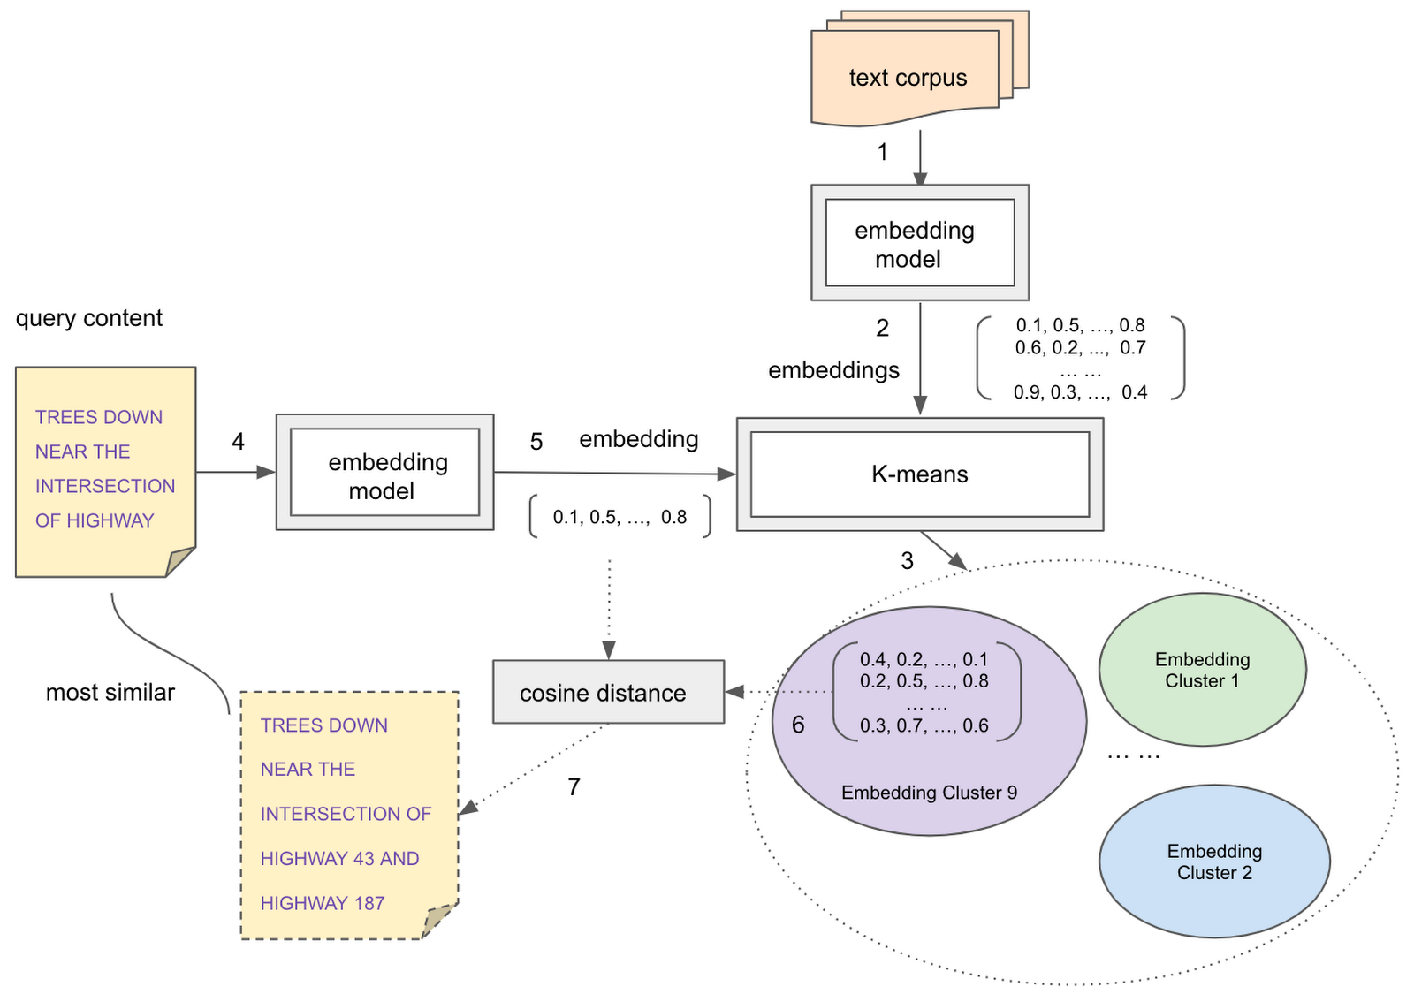

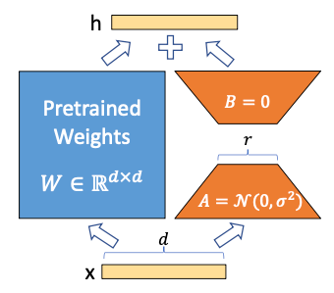
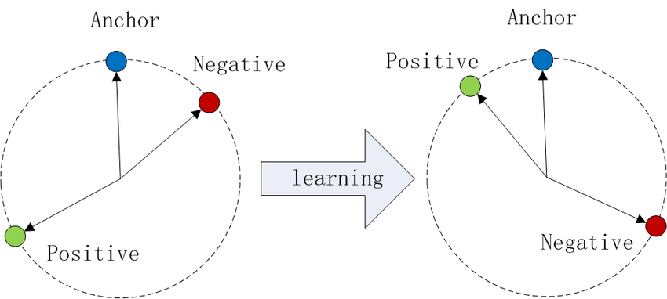
Our Solution Approach
Text embedding model: sentence-transformers from MTEB benchmark - Both text corpus related to Porsche car models and the queries are embedded into latent space
Similarity search: - ANN (approximate nearest neighbor) e.g. HNSW, Annoy, FAISS, and NMSLib
Fine-tuning: - Adapter + PEFT (LoRA/QLoRA) - Contrastive Loss
8 Fine-tuning
Image source: https://cloud.google.com/blog/products/data-analytics/introducing-bigquery-text-embeddings

Slide 11
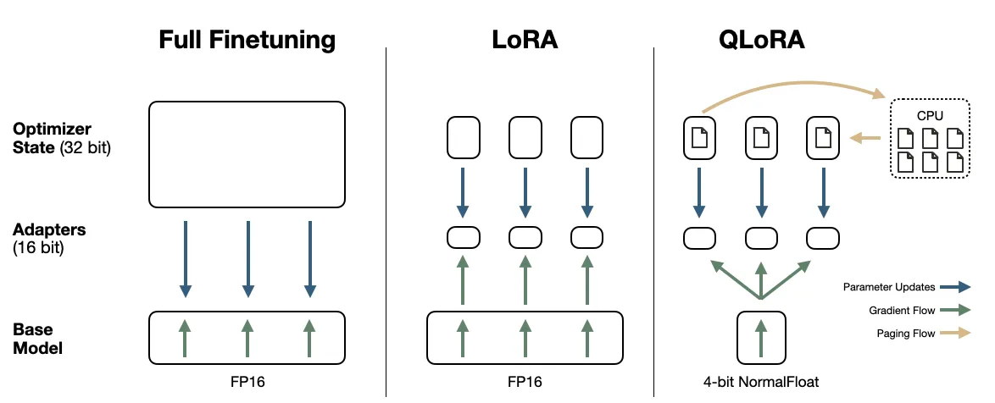
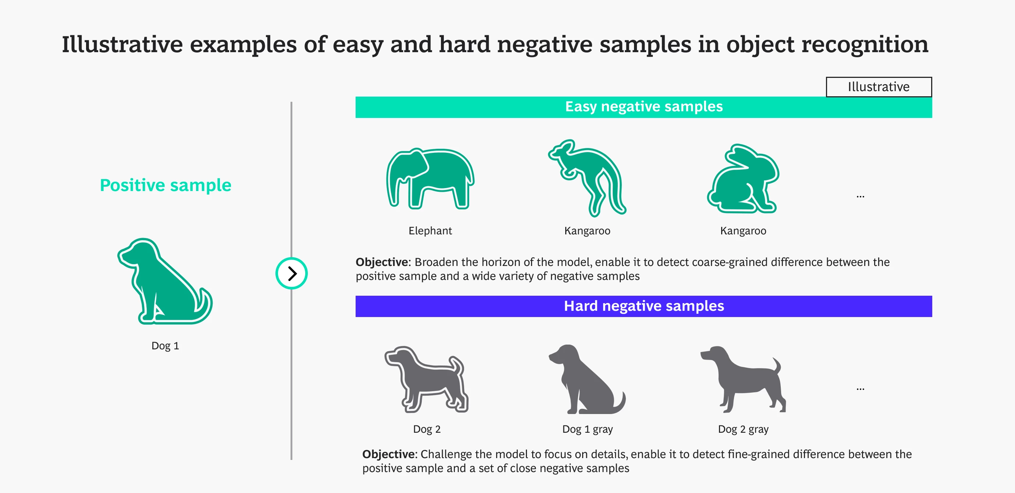
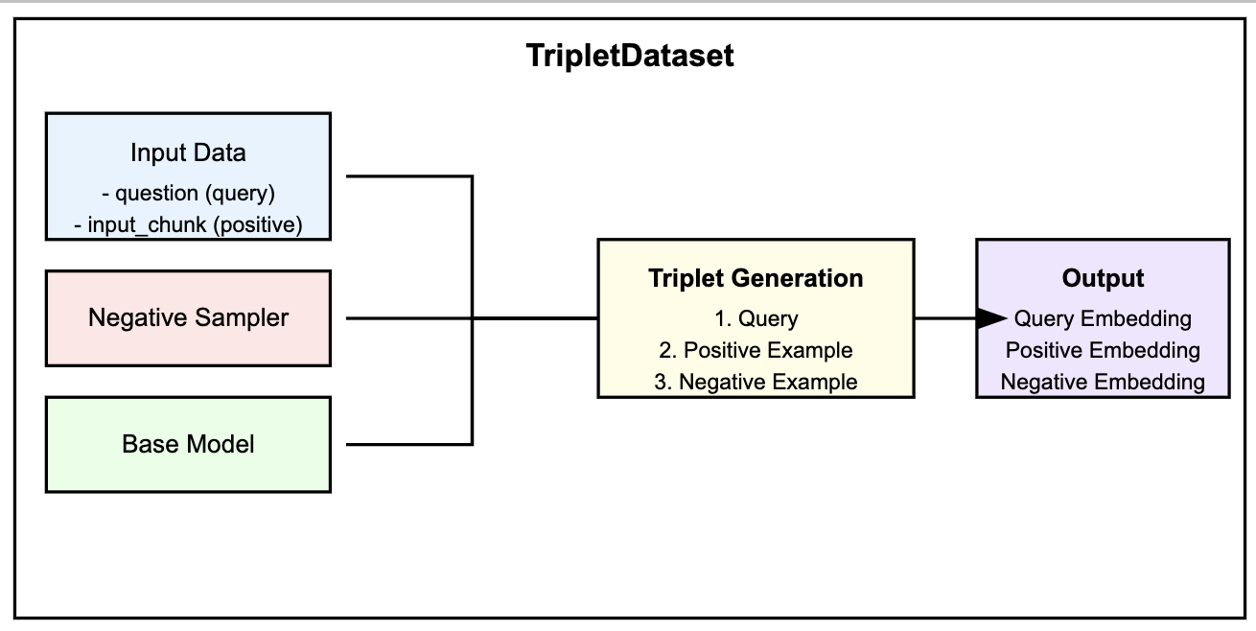
Our Solution Approach (cont’d)
More detailed about fine tuning approaches
Key ingredients behind QLoRA: (1) 4-bit NormalFloat (2) Double Quantization (3) Paged optimizers (avoid out-of-memory error during training) (4) LoRA: Low-rank Adaptation Contrastive loss - Random negative sampling
Image source: https://cloud.google.com/blog/products/data-analytics/introducing-bigquery-text-embeddings

Slide 12
Outline
Introduction
Methodology
Current work
Future work

Slide 13
Up until now…
Data collection for fine-tuning:
- Web scrapping all Porsche vehicle model specification and latest newsroom for each car
model
- Synthetic data generated by knowledge base model (RAG) from Amazon AWS Bedrock
(we will, of course, double-check the correctness)
"question_1": "What is the combined CO₂ emissions for the 718 Cayman GTS 4.0?",
"pos_ans_1" : "The combined CO2 emissions for the 718 Cayman GTS 4.0 is 246 – 219 g/km.",
”neg_ans_1" : " The 718 Cayman GTS 4.0 produces zero CO₂ emissions because it is fully electric."
→ So far, we have collected 250 QA pairs for fine-tuning.

Slide 14
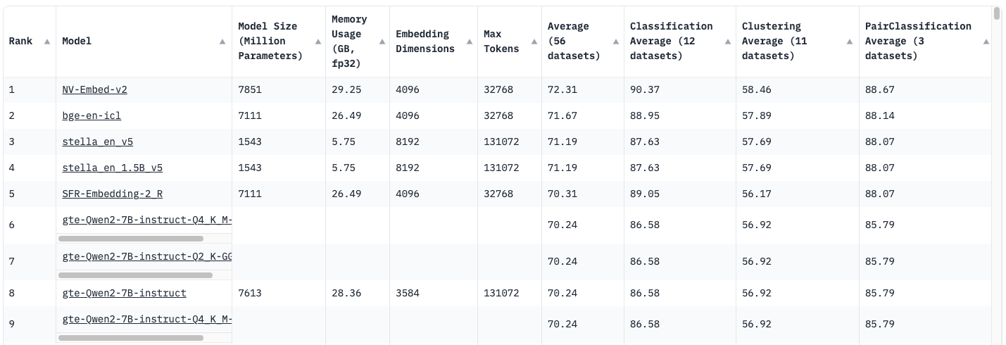
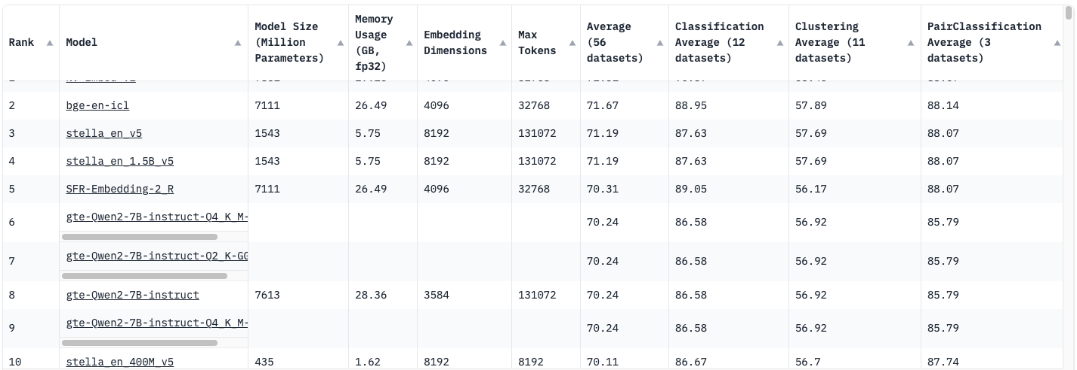

Up until now…
Embedding models selection from Hugging face MTEB leaderboard
→ So far, we have only tried “stella en 400M v5”, but in the future, we’ll also try other in comparison.

Slide 15
Outline
Introduction
Methodology
Current work
Future work

Slide 16
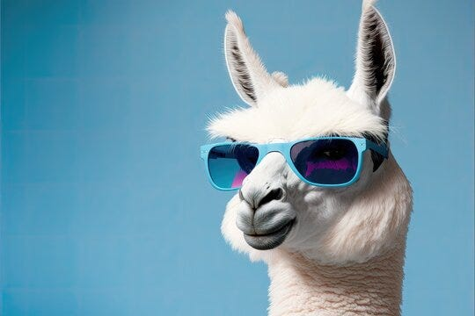






Future work
Fine-tuning the embedding model
- Replicate some research papers from TUM and ChromaDB
- Loss functions and evaluation methods from SBERT library - Compare the similarity score, for example, with the pre-trained embedding model
Extension to recommendation systems - Get some example ideas from OpenAI cookbook and try to extend to be Porsche-specific - Use open-source LLM (e.g. LLaMA or Falcon) to generate response - Some others that might possibly be used: - Orchestration framework like LlamaIndex or Langchain - Vector database, e.g. Chroma - GUI interface, e.g. Gradio or Streamlit

Slide 17


Expected results
If I need larger car trunk capacity, which car model would you recommend me?"
Before fine-tuning
After fine-tuning
Based on the available search results, I cannot provide a comprehensive comparison of trunk or cargo space across all Porsche models. The search results only mention that some models like the Taycan and 718 have two luggage compartments, but do not specify their exact volumes. However, without specific cargo space measurements, I cannot definitively state which model has the largest trunk space.
The Cayenne is Porsche‘s largest SUV, and it’s also the one that offers the most cargo space. The capacity specification is as follows:
Luggage compartment volume, rear V210-2
698 l
Open luggage compartment volume (up to the upper edge of the rear seats)
772 l
Largest luggage compartment volume (behind front seats, up to roof)
1,708 l

Slide 18
Potential challenges
Insufficient data
Computational resource limitations

Slide 19
Reference
1. Schopf, T., Schneider, D. N., & Matthes, F. (2023). Efficient Domain Adaptation of Sentence Embeddings Using Adapters. ArXiv, 1046–1053. https://doi.org/10.26615/978-954-452-092-2_112
2. Wang, L., Yang, N., Huang, X., Yang, L., Majumder, R., & Wei, F. (2023, December 31). Improving Text Embeddings with Large Language Models. arXiv.org. https://arxiv.org/abs/2401.00368
3. Embedding adapters. (n.d.). Chroma Research. https://research.trychroma.com/embedding-adapters
4. Paluszkiewicz, A. (2023, September 14). The impact of AI on the automotive industry. Digica | AI Powered Software. https://www.digica.com/blog/the-impact-of-ai-on-the-automotive-industry.html
5. Dettmers, T., Pagnoni, A., Holtzman, A., & Zettlemoyer, L. (2023, May 23). QLORA: Efficient Finetuning of Quantized LLMS. arXiv.org. https://arxiv.org/abs/2305.14314
6. Hu, E. J., Shen, Y., Wallis, P., Allen-Zhu, Z., Li, Y., Wang, S., Wang, L., & Chen, W. (2021, June 17). LORA: Low-Rank adaptation of Large Language Models. arXiv.org. https://arxiv.org/abs/2106.09685

Slide 20
THANK YOU.
FEEDBACK?

